Slide 1
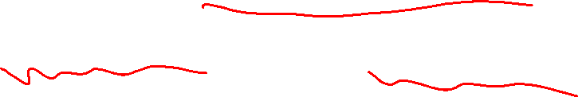
Section 1.8 Solving Absolute Value Equations and Inequalities
Lecture 1
Idea of Absolute Value
Solving Equations

Slide 2

Section 1.8 Homework Submission to Canvas
Preview of section
Skim the section in text and write a short paragraph summary.
Give a bulleted list of all important definitions, theorems, and formulas without details.
Notes on video lectures
Take notes on everything written on slides including all details, worked examples, on-own activities, as well as your own thoughts and questions.
Try on-own activities first, then write down provided solution next to it for comparison.
Worked examples from the text
Write down the problem and attempt without looking at the solution.
Use the solution to write the best explanation you can.
Solutions to textbook exercises
Model approaches and explanations given in the video lectures and textbook examples.
Final reflection of section
List the key takeaways to remember as a bulleted list.

Slide 3
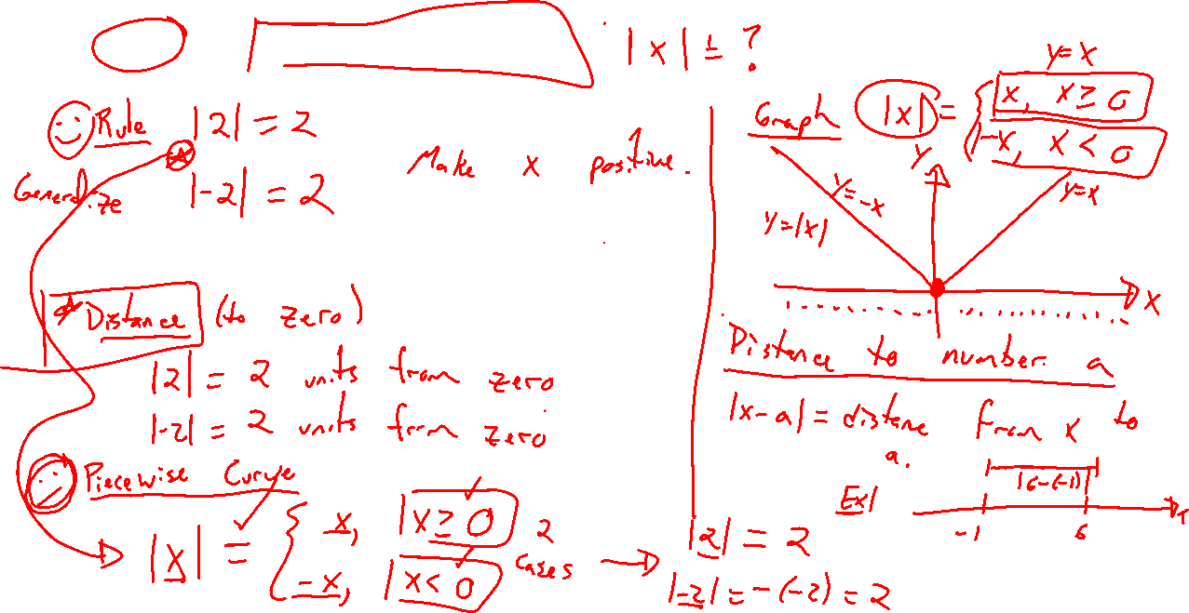
Idea of Absolute Value
Notes:
Distance from zero
Piecewise definition
Graph via PW definition
Important when thinking of size

Slide 4
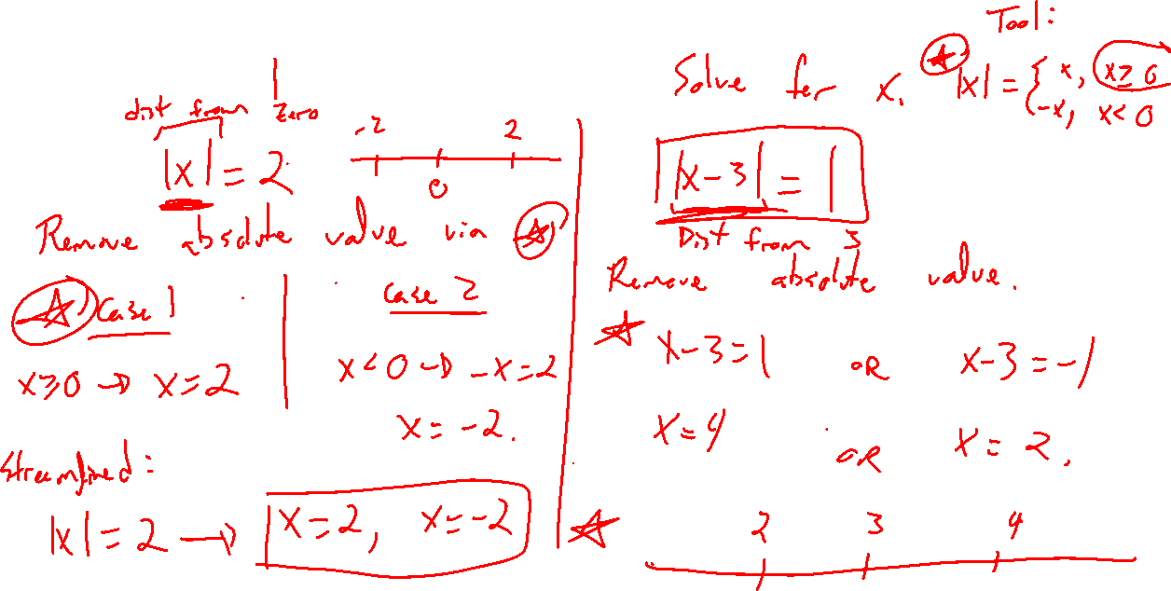
Example: Basic Equations
Notes:
|x|=2
|x-3|=1
Graphs for each

Slide 5
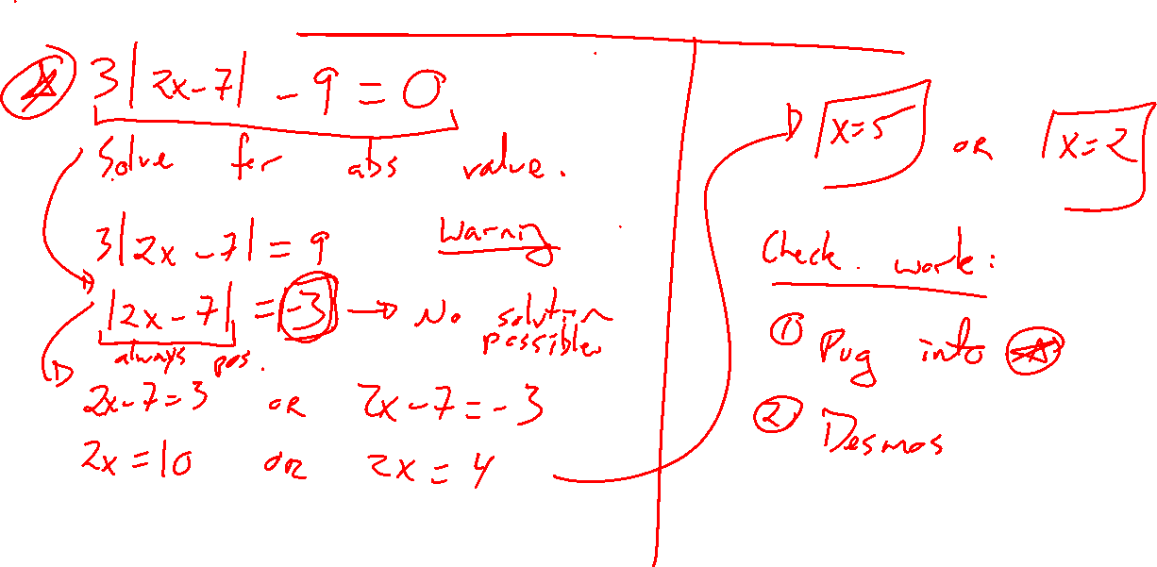
Example: Removing Absolute Value
Notes:
3|2x-7|-9=0
What is +9? |x|>=0
Check via desmos

Slide 6
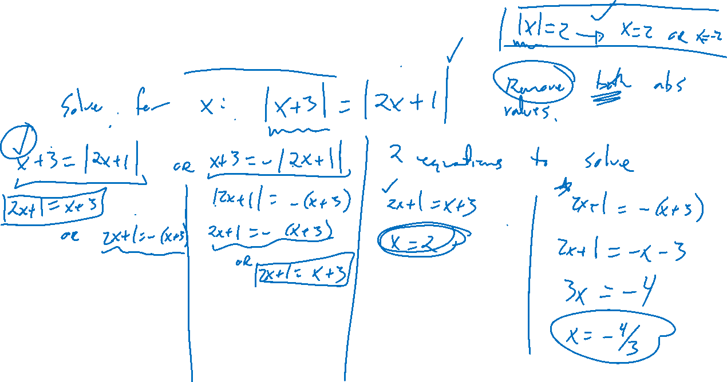
Example: Try on Own
Notes:
Challenge: |x+3|=|2x+1|
Check via desmos

